Slide 1
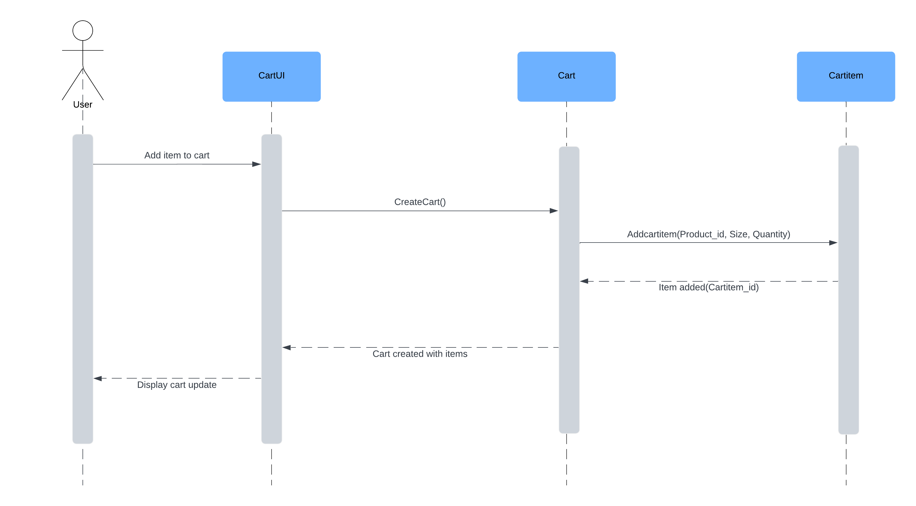
STYLEHIVE – SEQUENCE DIAGRAM S3
03.01 Add Items to Cart
User Story Outline
The user interacts with the CartUI to add an item to their shopping cart.
CartUI delegates the task to CartService, which further calls CartItemService to add the specific item.
Upon successful addition, the updated cart details are displayed to the user.

Slide 2
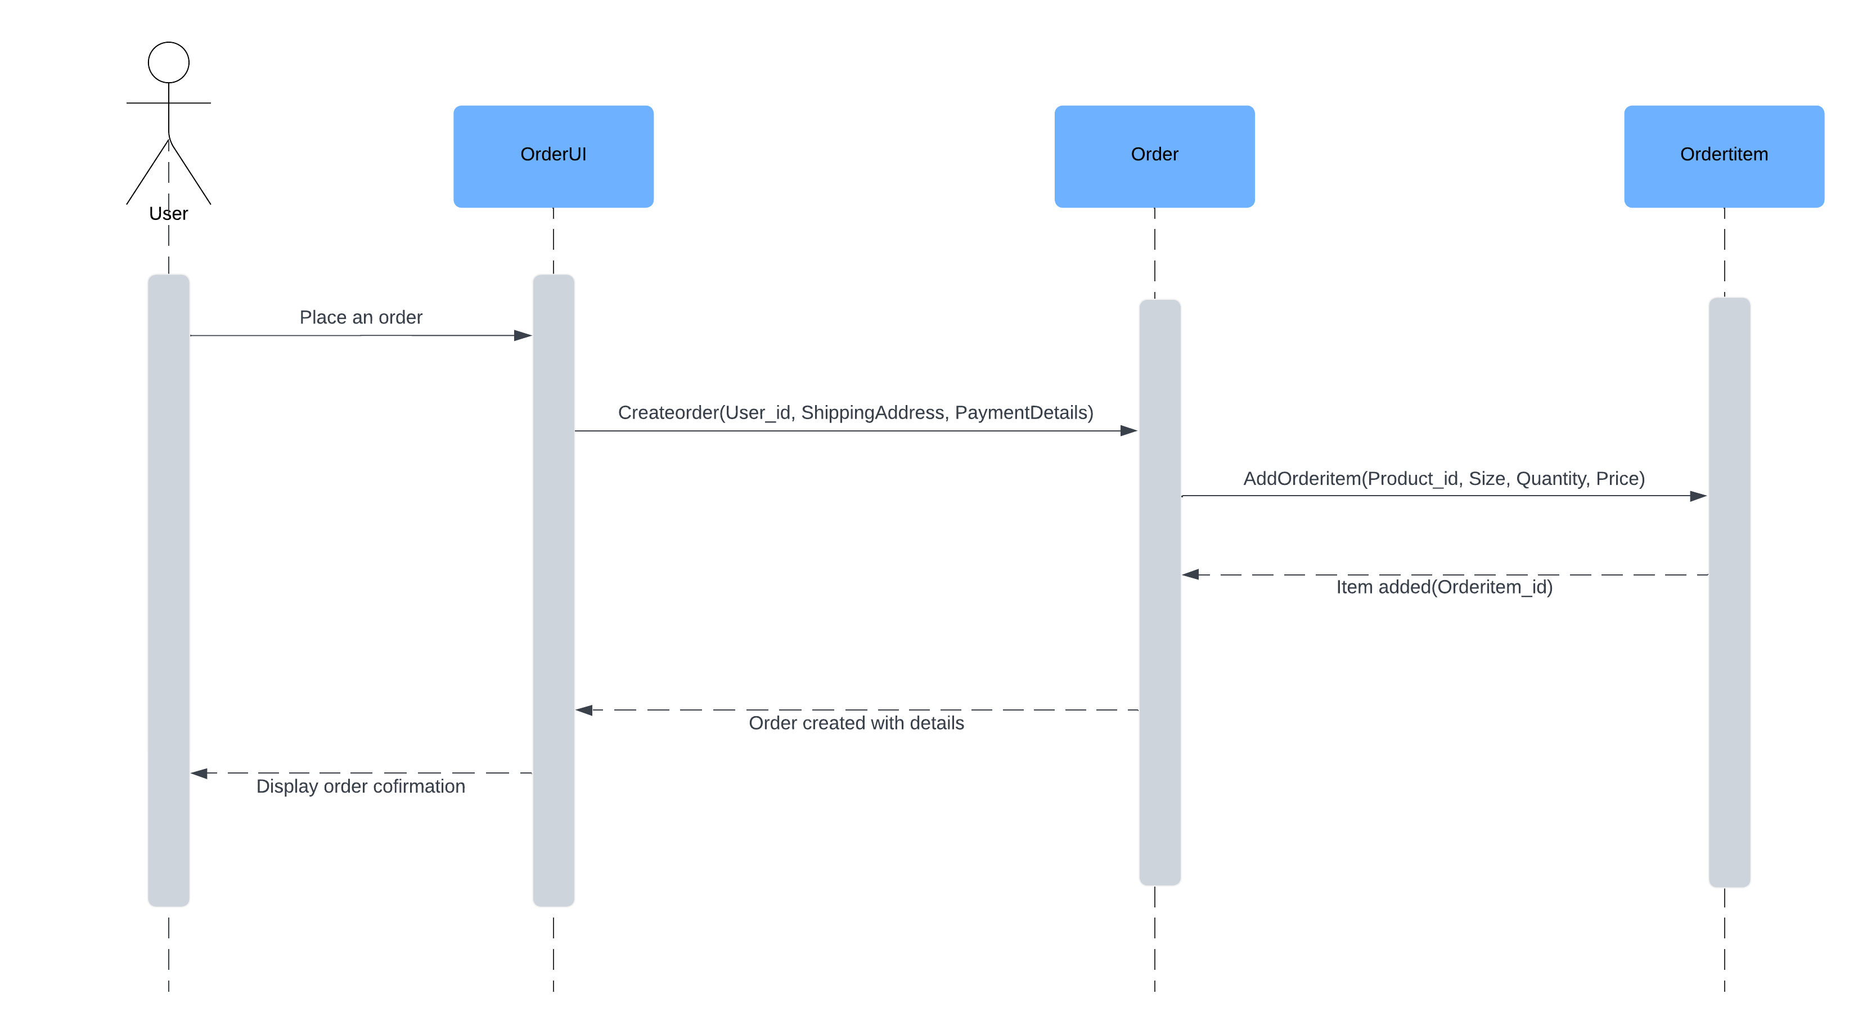
User Story - 03.02 Order Placement
User Story Outline
The user places an order through the OrderUI.
OrderUI invokes OrderService to create the order and OrderItemService to add order items.
Once the order is created, the user receives a confirmation.

Slide 3
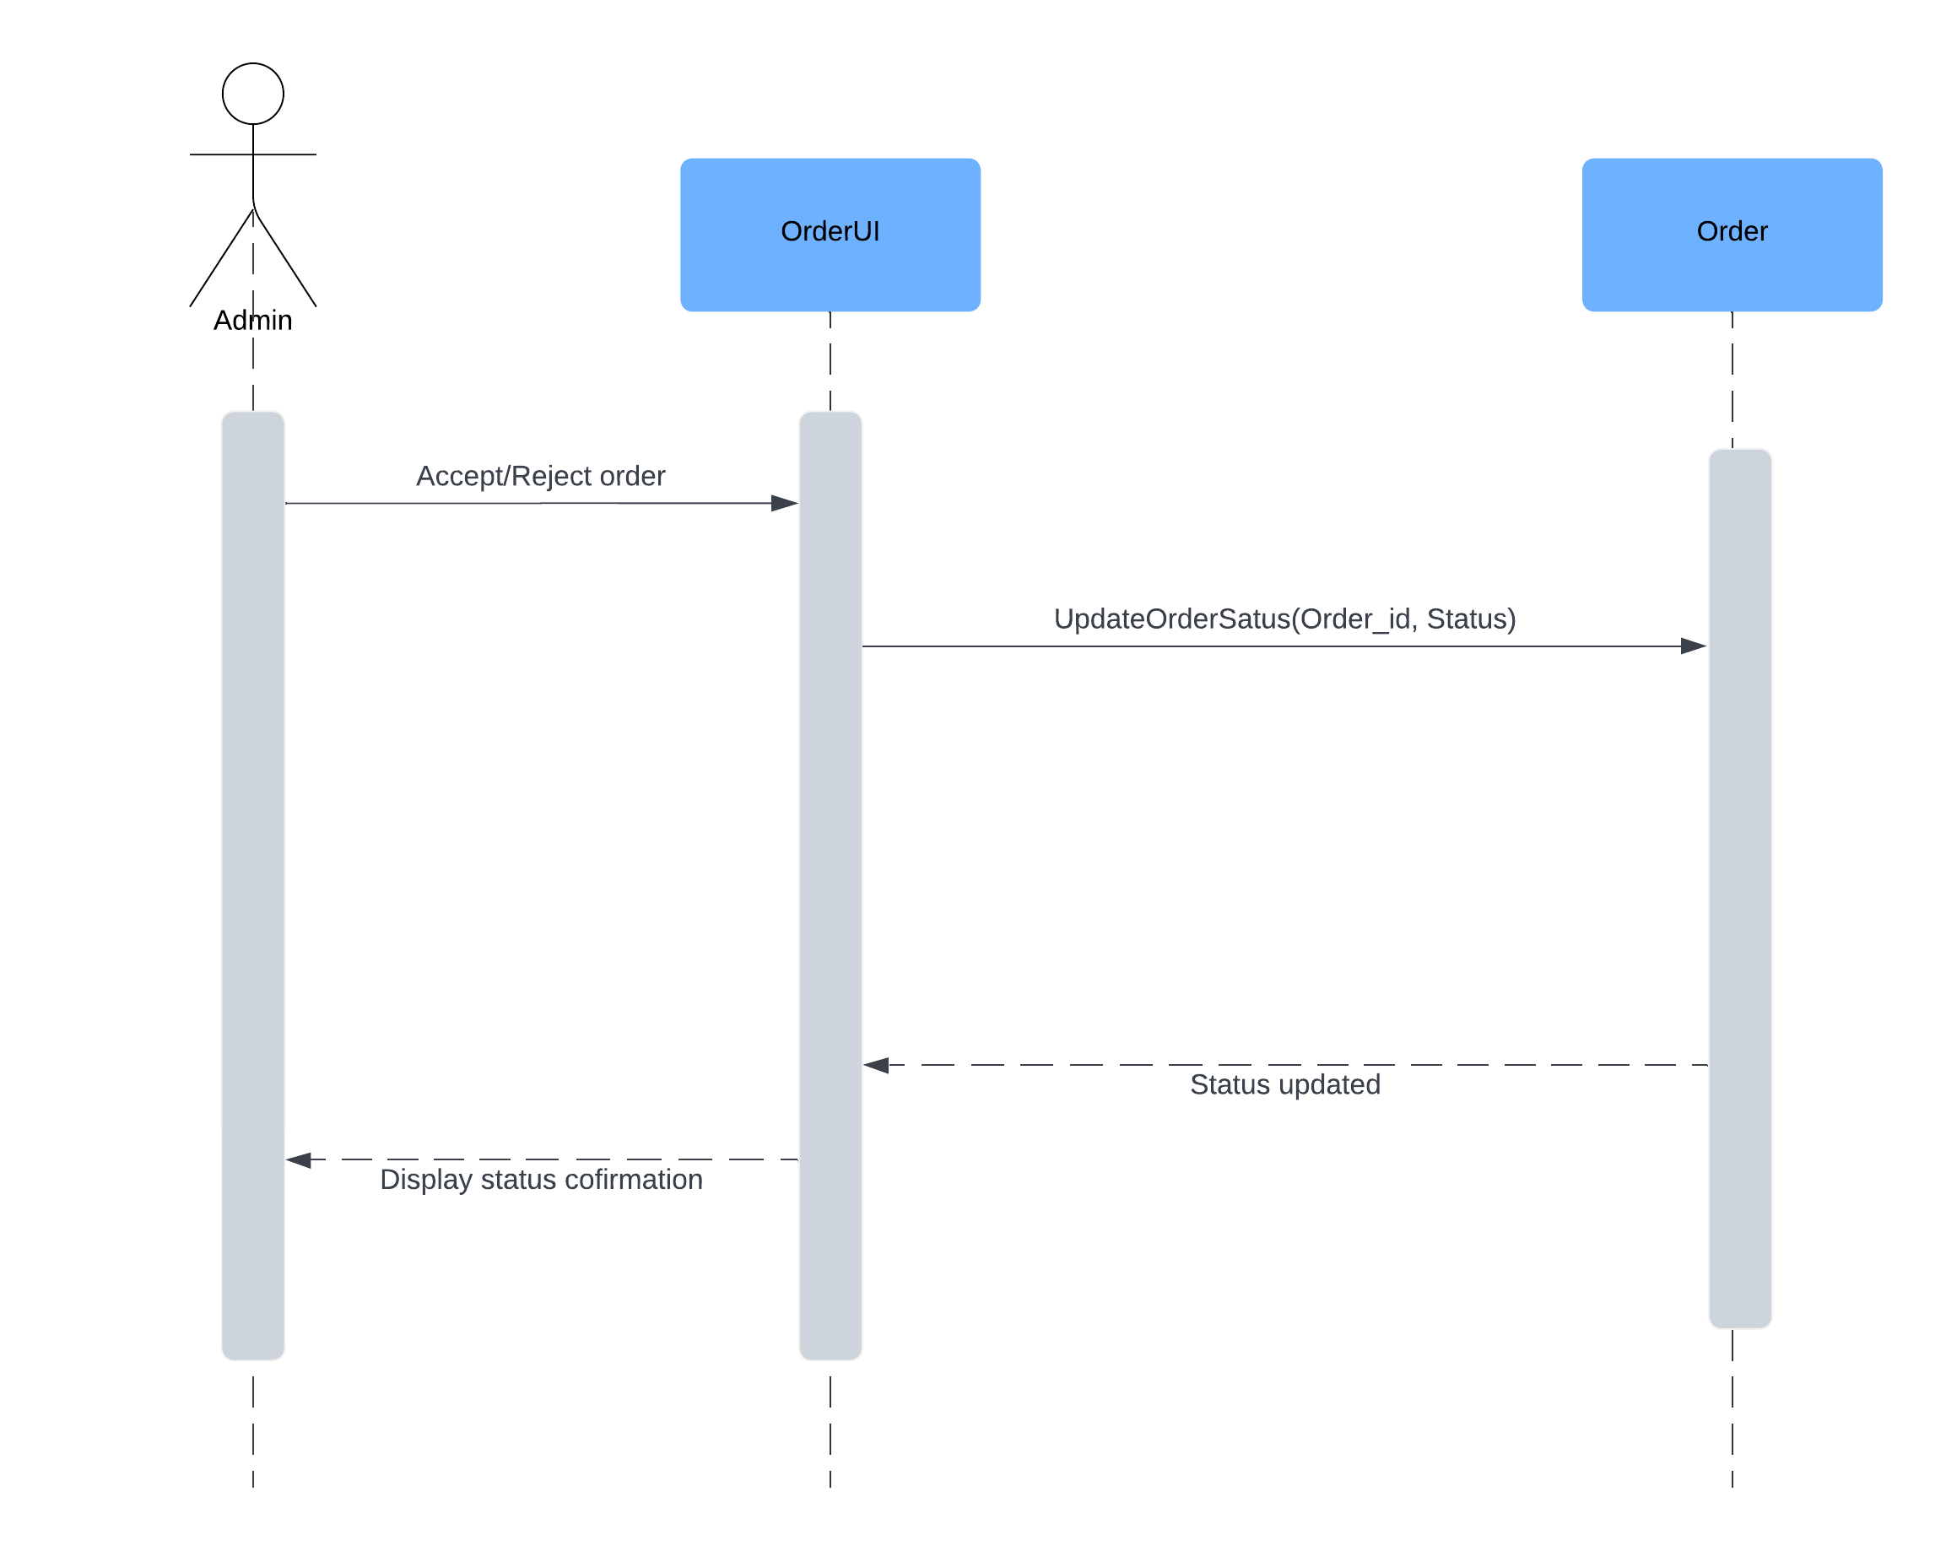
User Story - 03.03 Accept/Reject Orders
User Story Online
The admin interacts with OrderUI to accept or reject an order.
OrderUI forwards the status update to OrderService, and the admin is notified of the updated status.

Slide 4

User Story - 03.04 Update Order Status
User Story Outline
Similar to accept/reject orders, the admin uses OrderUI to change an order's status (e.g., "In Progress" or "Completed").
The status update is processed via OrderService and reflected back to the admin.

Slide 5
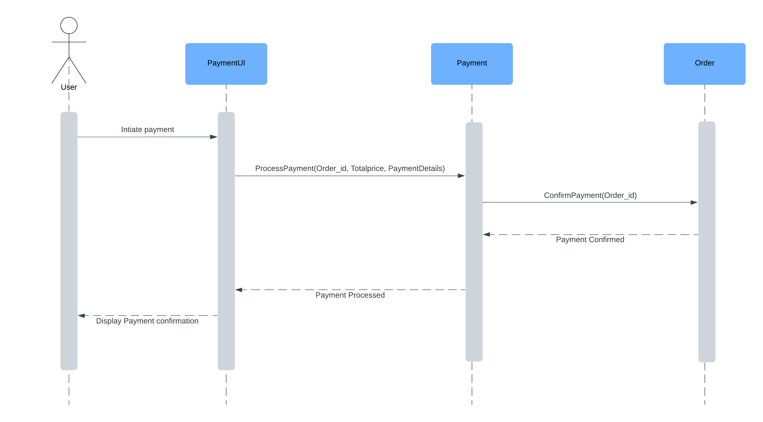
User Story – 04.01 Process Payments
User Story Outline
The user initiates payment through PaymentUI, which processes the payment via PaymentService.
PaymentService interacts with OrderService for payment confirmation, and the user is notified upon success.

Slide 6
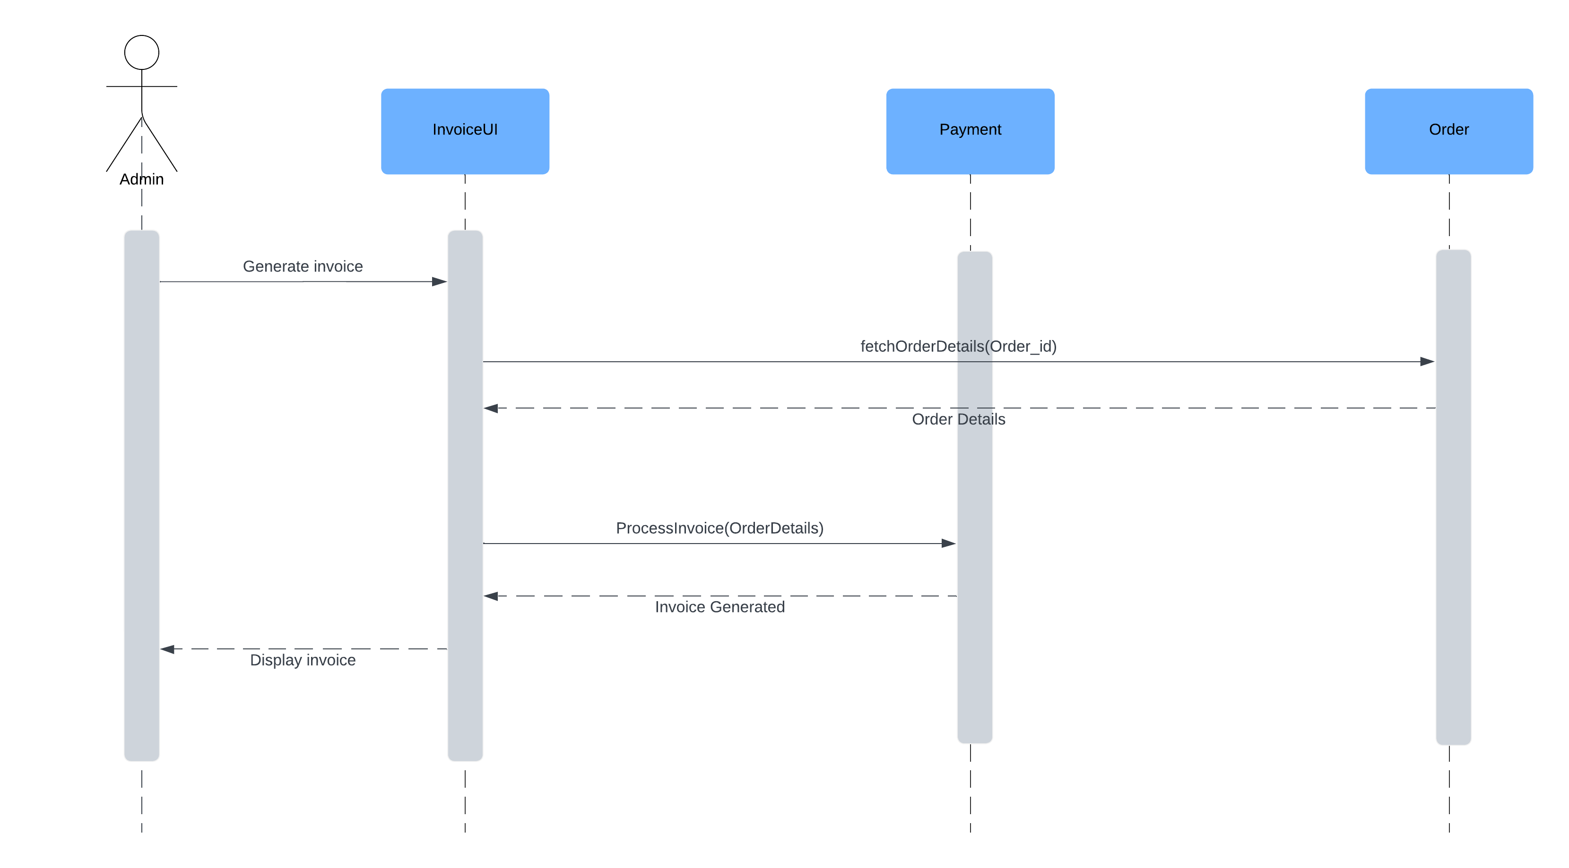
User Story – 04.02 Generate Invoice
User Story Outline
The admin requests an invoice from FinanceUI, which passes the request to FinanceService.
FinanceService retrieves order details from OrderService, generates the invoice, and displays it to the admin.

Slide 7
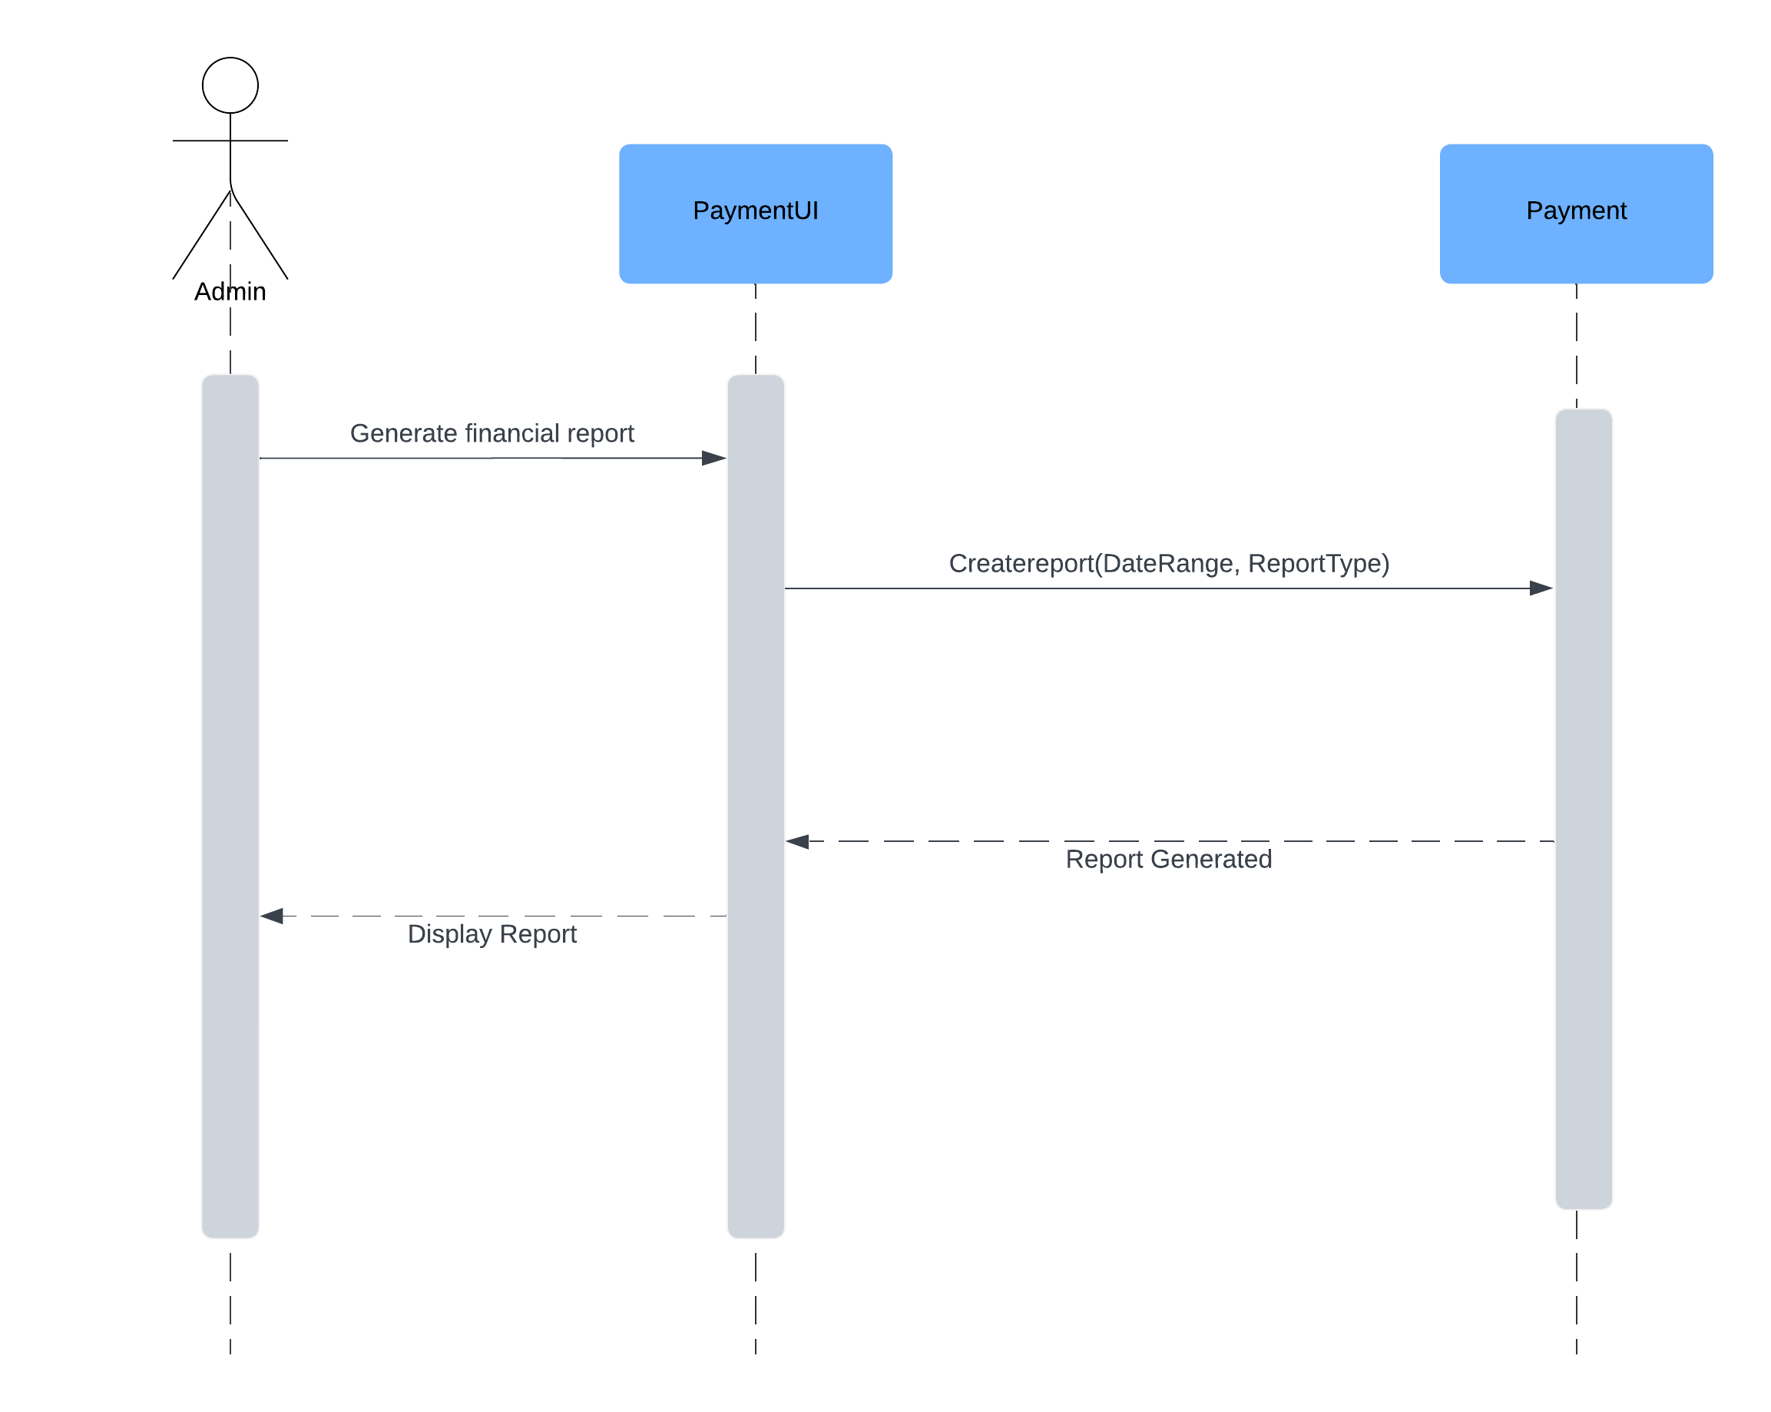
User Story – 04.03 Create Financial Reports
User Story Outline
The admin uses FinanceUI to generate financial reports for a specific date range or type.
FinanceService generates the report and displays it to the admin.

Slide 8
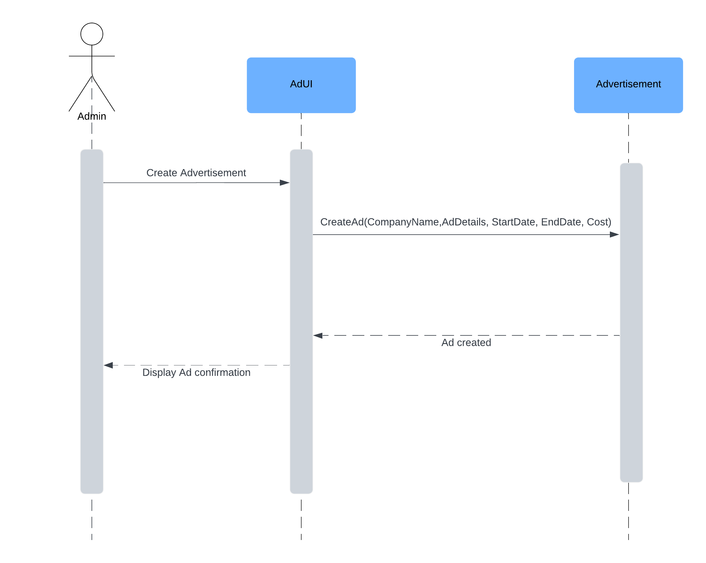
User Story – 05.01 Create Ad
User Story Outline:
The admin creates an advertisement via AdUI, which forwards the details to AdService.
Once the ad is successfully created, a confirmation is shown.

Slide 9

User Story – 05.02 Update Ad
User Story Outline
The admin updates an advertisement using AdUI.
AdService processes the update, and the admin receives a confirmation.

Slide 10
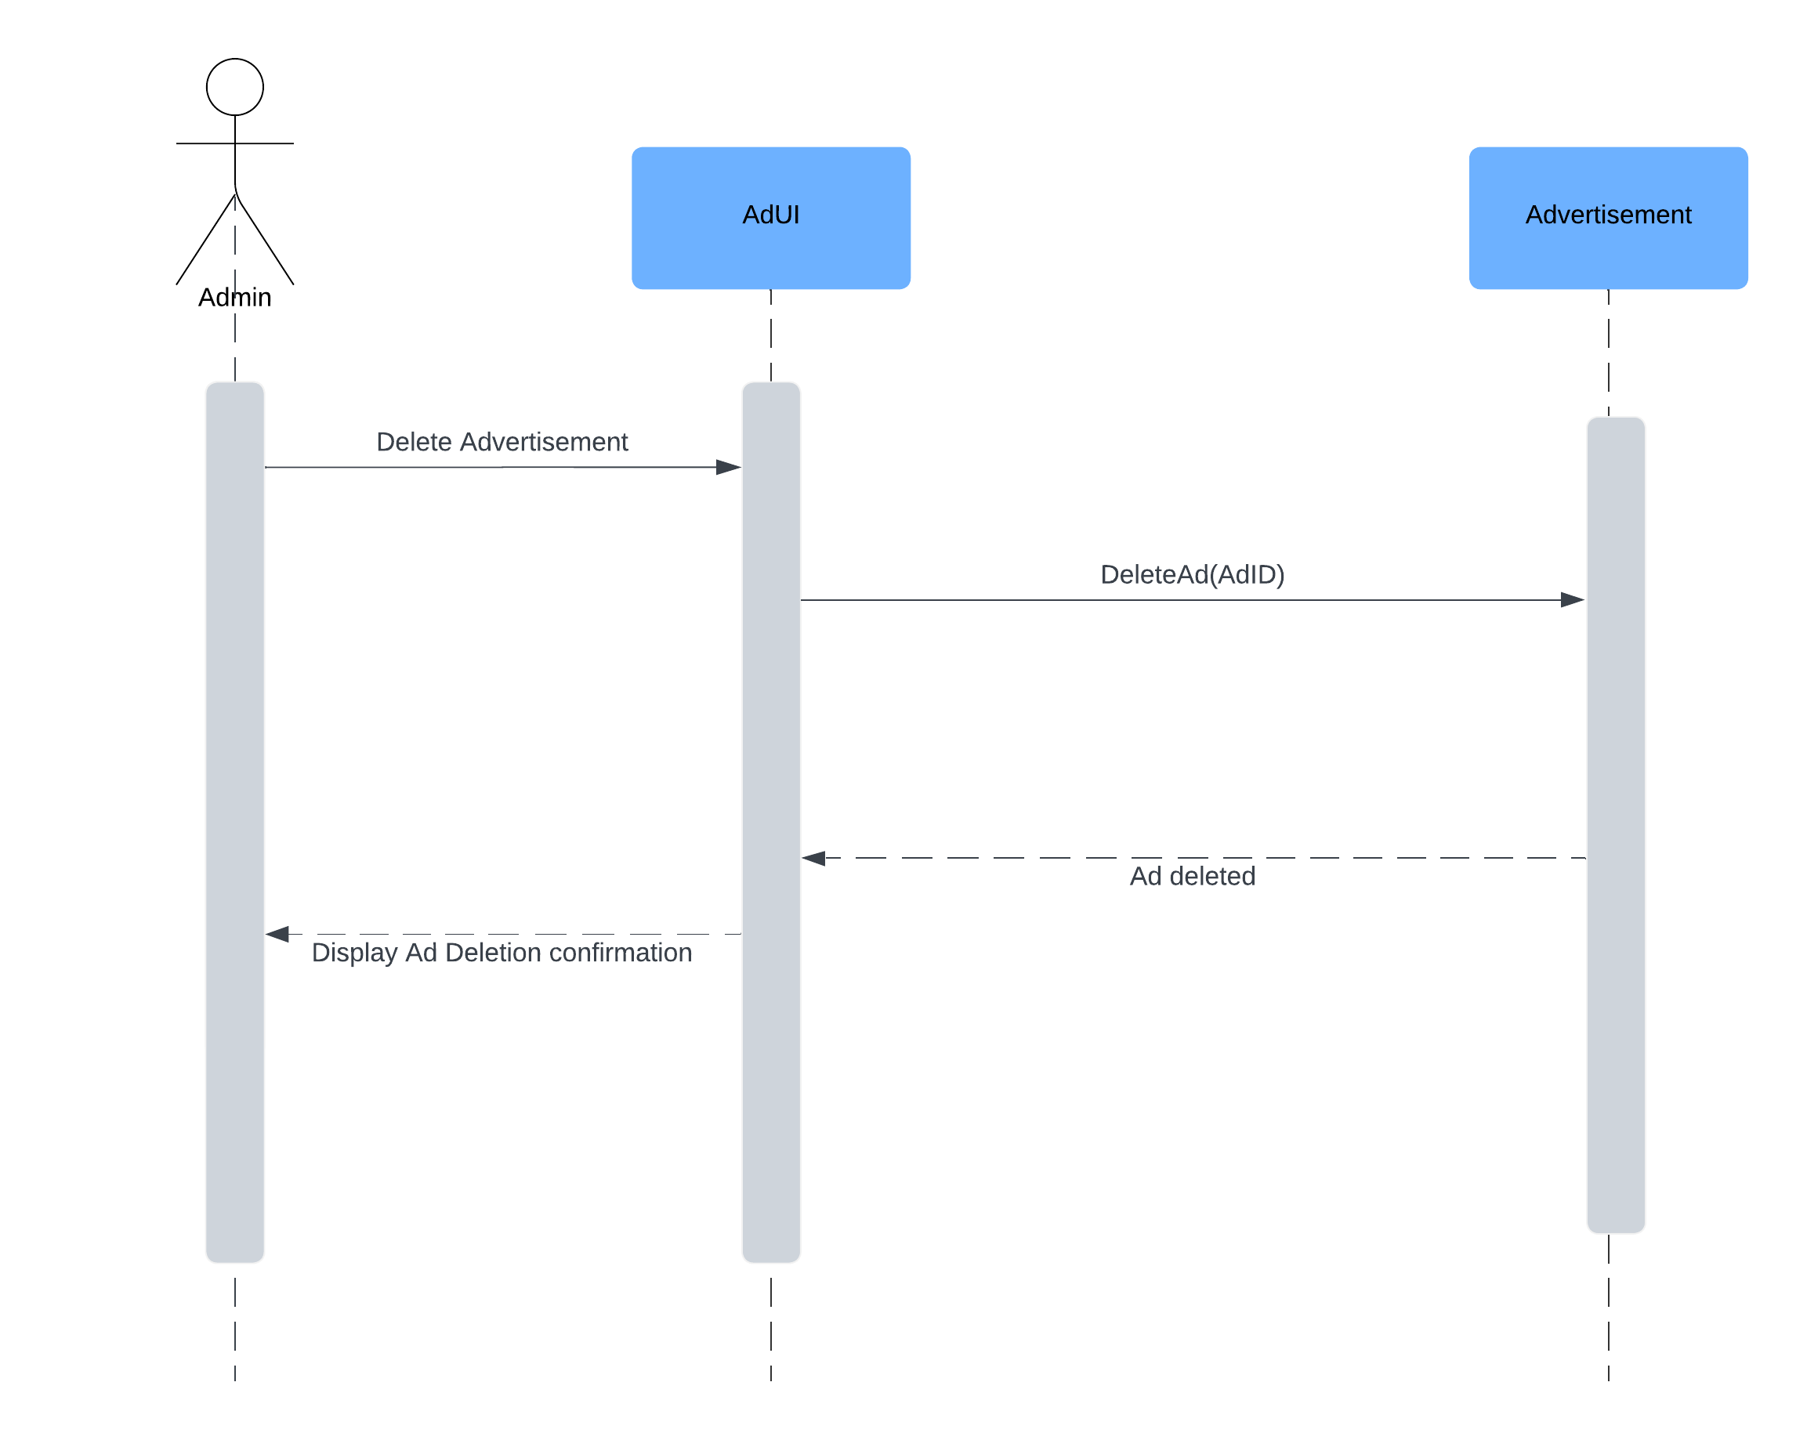
User Story – 05.03 Delete Ad
User Story Outline
The admin deletes an advertisement through AdUI.
AdService handles the deletion, and the admin is informed of its success.

